Slide 1
Methods
Advantages & Disadvantages
 | Methods | Advantages | Disadvantages
Mean Brightness Preserving Histogram Equalization (MBPHE) | BBHE | Simple to implement, and can maintain brightness to some extent. | There are obvious deficiencies in the accuracy and stability of image brightness maintenance.
 | QBHE | Simple to implement, and can maintain brightness to some extent. | The association information between pixels is ignored.
 | DSIHE | Simple to implement. Maximum Shannon Entropy is provided. | Does not enhance contrast very effectively.
 | MMBEBHE | Provide clear results with good brightness preservation and contrast enhancement. | There are many iterations so that the time complexity is high.
 | RMSHE | Provide smoother brightness preservation results. | Recursive procedure increases the time complexity. When the recursion parameter γ are large enough, the effect of image enhancement will degrade seriously.
 | RSIHE | Provide smoother brightness preservation results.
 | RSWHE | Provide smoother brightness preservation results. Image features can be preserved while enhancing contrast | The association information between pixels is ignored.
 | Methods | Advantages | Disadvantages
Local Histogram Equalization (LHE) | CLAHE | Smoother histogram. Details are preserved. The problem of amplifying noise is solved. | Focus on optimizing the contract. The output image is very different from the original one.
 | POSHE | Keep a good enhancement ability while reducing the computational complexity. | Inevitable blocking effect.
 | AHE | Improve the local contrast. Get more details. | Magnify image noise.
 | BPDHE | Considering the distribution of the original histogram, the appropriate region is selected according to the distribution. | High computational complexity.
Clipping-Based Histogram Equalization (CBHE) | WTHE | Excessive contrast enhancement can be avoided. | The automation of this algorithm is low and the procedure is not intuitive.
 | BUBOHE | Excessive contrast enhancement can be avoided. | It’s difficult to find an optimal hyper-parameters.
 | AMHE | Excessive contrast enhancement can be avoided. | High computational complexity.
 | ESIHE | Excessive contrast enhancement can be avoided. | It’s difficult to find an optimal hyper-parameters.

Slide 2
References
Paper links
 | Methods | Links
Mean Brightness Preserving Histogram Equalization (MBPHE) | BBHE | https://ieeexplore.ieee.org/abstract/document/580378
 | QBHE | https://ieeexplore.ieee.org/abstract/document/595370
 | DSIHE | https://ieeexplore.ieee.org/abstract/document/754419
 | MMBEBHE | https://ieeexplore.ieee.org/abstract/document/1261234
 | RMSHE | https://ieeexplore.ieee.org/abstract/document/1261233
 | RSIHE | https://www.sciencedirect.com/science/article/pii/S0167865507000578?casa_token=7TmXPEj-l6sAAAAA:mcGaEP_1ZJtVDNKsGZ6uQWjtEg-6Dyh58pjs2wyENTQhwGPcZ6zge0SC8lltS_2fps44WyxMbp8
 | RSWHE | https://ieeexplore.ieee.org/abstract/document/4637632
 | Methods | Links
Local Histogram Equalization (LHE) | CLAHE | https://link.springer.com/article/10.1007%2FBF03178082
 | POSHE | https://ieeexplore.ieee.org/abstract/document/915354 https://www.sciencedirect.com/science/article/pii/S135044951730155X?casa_token=eJUkMwf3--0AAAAA:3965n7vmwv26y1HQV1xohdwZ9nGvjTTVRdGaSiv_WBvrBYld0szxz7fAVmOqw-ha0mHbVdgbrpQ https://ieeexplore.ieee.org/abstract/document/1706495
 | AHE | https://www.sciencedirect.com/science/article/abs/pii/S0734189X8780186X
 | BPDHE | https://ieeexplore.ieee.org/abstract/document/4266947 https://ieeexplore.ieee.org/abstract/document/4429280
Clipping-Based Histogram Equalization (CBHE) | WTHE | https://ieeexplore.ieee.org/abstract/document/4429280 https://ieeexplore.ieee.org/abstract/document/5722541
 | BUBOHE | https://ieeexplore.ieee.org/abstract/document/1247104
 | AMHE | https://link.springer.com/chapter/10.1007/11949534_116
 | ESIHE | https://www.sciencedirect.com/science/article/pii/S0030402614006111?casa_token=FfZntslCMfsAAAAA:3M8PQm2aM0vMwZP9nu5s4VyJuC_3m2Atj0ThpjgEmMJbsRttsO6saNxpXjn-ujqfc8IDGiK2lq0 https://www.sciencedirect.com/science/article/pii/S0167865513003280?casa_token=97Vgv4Q2HQAAAAAA:WvcPyKWYeOleFK1fBISNUJ4R-NvAhvZpHHCGjtTHt0kBoJqxMazUdnv0PnoSeag-wXOrukMBXL4

Slide 3
PSNR
Peak Signal-to-Noise Ratio
 | Methods
 | Mean Brightness Preserving Histogram Equalization |  |  |  |  |  |  | Local Histogram Equalization |  |  |  | Clipping-Based Histogram Equalization
Image | BBHE | QBHE | DSIHE | MMBEBHE | RMSHE | RSIHE | RSWHE | CLAHE | POSHE | AHE | BPDHE | WTHE | BUBOHE | AMHE | ESIHE
Photographer | 17.92 | 15.28 | 18.11 | 21.02 | 20.43 | 21.04 | 32.98 | 19.27 | 12.22 | 13.64 | 22.84 | 18.33 | 18.64 | 26.34 | 19.08
House | 19.40 | 17.28 | 18.55 | 22.53 | 23.03 | 23.54 | 35.62 | 19.67 | 13.89 | 13.76 | 22.89 | 17.23 | 10.52 | 26.89 | 19.67
Green Pepper | 20.58 | 18.16 | 20.56 | 20.27 | 25.03 | 24.87 | 30.12 | 18.82 | 18.01 | 18.10 | 28.51 | 21.04 | 20.59 | 29.63 | 22.58
Starfish | 26.80 | 19.17 | 26.70 | 26.94 | 40.47 | 41.54 | 50.27 | 16.31 | 15.33 | 15.74 | 37.33 | 27.98 | 23.06 | 33.35 | 20.29
Butterfly | 24.63 | 19.28 | 23.76 | 25.68 | 29.85 | 29.33 | 36.78 | 16.46 | 15.61 | 15.07 | 23.95 | 20.82 | 17.95 | 28.97 | 25.97
Plane | 24.19 | 18.93 | 15.74 | 23.64 | 28.25 | 26.34 | 36.88 | 17.28 | 11.42 | 11.74 | 20.53 | 17.80 | 13.25 | 19.10 | 12.27
Parrot | 20.80 | 17.88 | 20.54 | 26.63 | 29.86 | 28.87 | 41.25 | 18.15 | 14.37 | 15.31 | 30.58 | 25.15 | 20.91 | 35.83 | 29.67
Woman | 20.87 | 17.20 | 20.84 | 25.96 | 28.71 | 28.02 | 34.19 | 18.25 | 16.94 | 17.23 | 27.72 | 20.67 | 18.66 | 28.54 | 24.64
Sitting Woman | 23.04 | 18.37 | 23.04 | 23.47 | 30.03 | 29.24 | 36.77 | 17.48 | 16.98 | 17.34 | 28.15 | 23.14 | 19.88 | 30.82 | 26.36
Ship | 16.77 | 14.18 | 16.07 | 17.28 | 22.67 | 23.13 | 33.67 | 16.23 | 14.26 | 14.72 | 18.63 | 17.34 | 17.08 | 24.84 | 21.58
Man | 20.45 | 17.33 | 20.45 | 22.92 | 25.01 | 25.00 | 33.68 | 17.91 | 16.45 | 16.37 | 16.29 | 19.29 | 16.60 | 31.01 | 23.07
Room | 16.79 | 14.32 | 16.87 | 16.88 | 23.43 | 22.91 | 32.31 | 17.36 | 16.14 | 16.25 | 17.54 | 19.04 | 16.47 | 30.47 | 24.29

Slide 4
MSE
Mean Absolute Error
 | Methods
 | Mean Brightness Preserving Histogram Equalization |  |  |  |  |  |  | Local Histogram Equalization |  |  |  | Clipping-Based Histogram Equalization
Image | BBHE | QBHE | DSIHE | MMBEBHE | RMSHE | RSIHE | RSWHE | CLAHE | POSHE | AHE | BPDHE | WTHE | BUBOHE | AMHE | ESIHE
Photographer | 1049.97 | 1928.40 | 1033.74 | 514.57 | 589.60 | 512.51 | 32.74 | 769.11 | 3899.12 | 2813.89 | 338.48 | 954.66 | 888.75 | 150.87 | 804.33
House | 747.07 | 1215.36 | 907.60 | 363.26 | 324.12 | 288.08 | 17.84 | 701.90 | 2656.69 | 2735.42 | 333.88 | 1229.68 | 5767.13 | 132.94 | 701.06
Green Pepper | 568.74 | 992.30 | 571.45 | 611.73 | 204.17 | 211.76 | 63.27 | 852.67 | 1029.00 | 1008.20 | 91.54 | 511.99 | 568.60 | 70.84 | 359.20
Starfish | 135.93 | 787.85 | 139.15 | 131.47 | 5.83 | 4.55 | 0.61 | 1522.06 | 1905.28 | 1734.11 | 12.01 | 103.48 | 321.14 | 30.05 | 607.89
Butterfly | 223.88 | 767.29 | 273.74 | 175.72 | 67.29 | 75.88 | 13.65 | 1469.85 | 1786.52 | 1748.44 | 261.89 | 538.14 | 1042.55 | 82.42 | 164.65
Plane | 247.81 | 832.26 | 1735.23 | 281.17 | 97.37 | 151.21 | 13.34 | 1217.05 | 4689.18 | 4358.46 | 575.31 | 1078.44 | 3047.97 | 799.92 | 3859.52
Parrot | 540.74 | 1058.33 | 574.51 | 141.08 | 67.14 | 84.30 | 4.88 | 996.56 | 2377.64 | 1916.27 | 56.89 | 198.42 | 527.34 | 16.70 | 70.10
Woman | 532.54 | 1240.22 | 535.97 | 164.88 | 87.60 | 102.57 | 24.78 | 973.62 | 1315.07 | 1230.87 | 109.85 | 557.45 | 885.50 | 90.95 | 223.17
Sitting Woman | 322.65 | 945.73 | 322.65 | 292.20 | 64.51 | 77.48 | 13.69 | 1162.72 | 1302.61 | 1199.44 | 99.61 | 315.31 | 668.26 | 53.80 | 150.32
Ship | 1369.55 | 2484.59 | 1605.91 | 1217.29 | 352.02 | 316.39 | 27.91 | 1548.84 | 2437.25 | 2192.42 | 890.91 | 1198.88 | 1274.87 | 213.47 | 452.05
Man | 586.39 | 1203.54 | 587.62 | 331.60 | 205.00 | 205.54 | 27.89 | 1052.02 | 1473.31 | 1501.14 | 1528.77 | 766.38 | 1421.40 | 51.48 | 321.00
Room | 1363.24 | 2405.85 | 1336.75 | 1334.32 | 295.23 | 333.01 | 38.18 | 1194.74 | 1580.90 | 1541.42 | 1146.15 | 811.64 | 1466.01 | 58.42 | 242.13

Slide 5
AMBE
Absolute Mean Brightness Error
 | Methods
 | Mean Brightness Preserving Histogram Equalization |  |  |  |  |  |  | Local Histogram Equalization |  |  |  | Clipping-Based Histogram Equalization
Image | BBHE | QBHE | DSIHE | MMBEBHE | RMSHE | RSIHE | RSWHE | CLAHE | POSHE | AHE | BPDHE | WTHE | BUBOHE | AMHE | ESIHE
Photographer | 24.17 | 25.16 | 18.28 | 0.03 | 12.77 | 9.34 | 1.99 | 6.09 | 5.53 | 10.97 | 7.60 | 0.001 | 13.34 | 8.96 | 16.68
House | 12.69 | 8.59 | 11.76 | 0.11 | 4.33 | 1.42 | 0.45 | 5.63 | 10.15 | 4.81 | 11.07 | 0.20 | 6.71 | 10.49 | 10.50
Green Pepper | 1.53 | 2.07 | 1.37 | 0.17 | 4.51 | 3.74 | 2.44 | 3.71 | 4.43 | 5.43 | 5.94 | 0.02 | 7.53 | 4.02 | 5.49
Starfish | 0.17 | 4.51 | 1.07 | 0.02 | 1.00 | 0.68 | 0.16 | 0.24 | 0.86 | 3.46 | 0.34 | 0.02 | 10.00 | 1.43 | 5.16
Butterfly | 0.17 | 2.46 | 2.54 | 0.0006 | 0.72 | 1.86 | 0.49 | 16.33 | 15.94 | 16.36 | 9.51 | 0.55 | 22.52 | 5.00 | 2.28
Plane | 5.72 | 5.63 | 21.28 | 5.51 | 2.17 | 5.37 | 1.29 | 22.71 | 49.35 | 47.43 | 4.88 | 4.69 | 38.46 | 26.77 | 23.84
Parrot | 16.94 | 17.22 | 16.11 | 0.06 | 2.54 | 3.52 | 0.87 | 15.65 | 26.34 | 18.42 | 4.82 | 0.48 | 18.24 | 2.74 | 3.55
Woman | 9.76 | 7.88 | 7.20 | 0.13 | 2.95 | 3.73 | 1.45 | 4.50 | 5.25 | 4.78 | 8.20 | 0.06 | 12.86 | 2.17 | 5.96
Sitting Woman | 5.69 | 2.30 | 5.69 | 0.01 | 1.45 | 2.18 | 0.31 | 10.23 | 8.94 | 10.77 | 7.99 | 0.10 | 16.68 | 1.29 | 2.91
Ship | 19.98 | 18.40 | 2.33 | 0.01 | 6.54 | 5.93 | 1.26 | 1.10 | 3.78 | 1.13 | 10.00 | 0.0006 | 1.76 | 12.78 | 13.36
Man | 17.34 | 15.92 | 16.97 | 1.56 | 7.16 | 7.58 | 2.67 | 10.49 | 11.82 | 17.16 | 35.79 | 0.44 | 26.92 | 0.58 | 6.06
Room | 9.77 | 4.35 | 4.07 | 0.05 | 5.51 | 5.19 | 2.11 | 6.78 | 5.65 | 7.90 | 7.81 | 0.19 | 15.31 | 0.49 | 3.54

Slide 6
SSIM
Structure Similarity
 | Methods
 | Mean Brightness Preserving Histogram Equalization |  |  |  |  |  |  | Local Histogram Equalization |  |  |  | Clipping-Based Histogram Equalization
Image | BBHE | QBHE | DSIHE | MMBEBHE | RMSHE | RSIHE | RSWHE | CLAHE | POSHE | AHE | BPDHE | WTHE | BUBOHE | AMHE | ESIHE
Photographer | 0.77 | 0.57 | 0.75 | 0.83 | 0.88 | 0.82 | 0.98 | 0.69 | 0.41 | 0.47 | 0.90 | 0.80 | 0.80 | 0.98 | 0.90
House | 0.61 | 0.48 | 0.53 | 0.70 | 0.82 | 0.77 | 0.98 | 0.70 | 0.39 | 0.39 | 0.76 | 0.54 | 0.25 | 0.97 | 0.88
Green Pepper | 0.85 | 0.72 | 0.85 | 0.82 | 0.95 | 0.94 | 0.98 | 0.79 | 0.70 | 0.75 | 0.97 | 0.89 | 0.90 | 0.99 | 0.95
Starfish | 0.92 | 0.77 | 0.93 | 0.92 | 1.00 | 1.00 | 1.00 | 0.79 | 0.74 | 0.77 | 0.99 | 0.95 | 0.95 | 0.99 | 0.89
Butterfly | 0.90 | 0.76 | 0.89 | 0.92 | 0.97 | 0.97 | 1.00 | 0.78 | 0.70 | 0.73 | 0.95 | 0.86 | 0.90 | 0.99 | 0.97
Plane | 0.91 | 0.75 | 0.64 | 0.90 | 0.96 | 0.94 | 0.99 | 0.71 | 0.47 | 0.49 | 0.78 | 0.71 | 0.60 | 0.93 | 0.68
Parrot | 0.88 | 0.72 | 0.86 | 0.93 | 0.97 | 0.97 | 1.00 | 0.77 | 0.62 | 0.67 | 0.96 | 0.91 | 0.91 | 0.99 | 0.98
Woman | 0.86 | 0.71 | 0.85 | 0.95 | 0.97 | 0.97 | 0.99 | 0.76 | 0.67 | 0.71 | 0.97 | 0.88 | 0.89 | 0.98 | 0.97
Sitting Woman | 0.90 | 0.75 | 0.99 | 0.89 | 0.98 | 0.97 | 0.99 | 0.83 | 0.77 | 0.82 | 0.98 | 0.89 | 0.93 | 0.99 | 0.96
Ship | 0.72 | 0.57 | 0.60 | 0.68 | 0.87 | 0.88 | 0.98 | 0.66 | 0.57 | 0.59 | 0.73 | 0.68 | 0.68 | 0.95 | 0.91
Man | 0.88 | 0.69 | 0.87 | 0.87 | 0.94 | 0.94 | 0.99 | 0.77 | 0.69 | 0.72 | 0.91 | 0.80 | 0.87 | 0.98 | 0.91
Room | 0.71 | 0.57 | 0.69 | 0.67 | 0.92 | 0.92 | 0.99 | 0.75 | 0.69 | 0.70 | 0.78 | 0.79 | 0.78 | 0.98 | 0.94

Slide 7

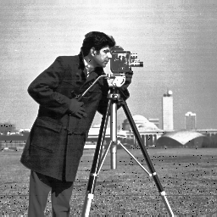
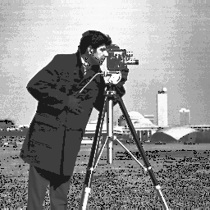
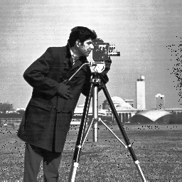
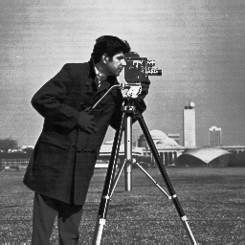
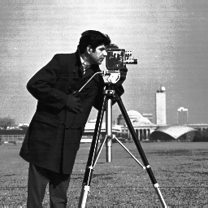
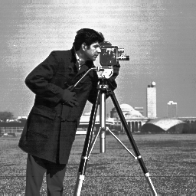
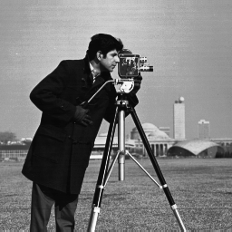
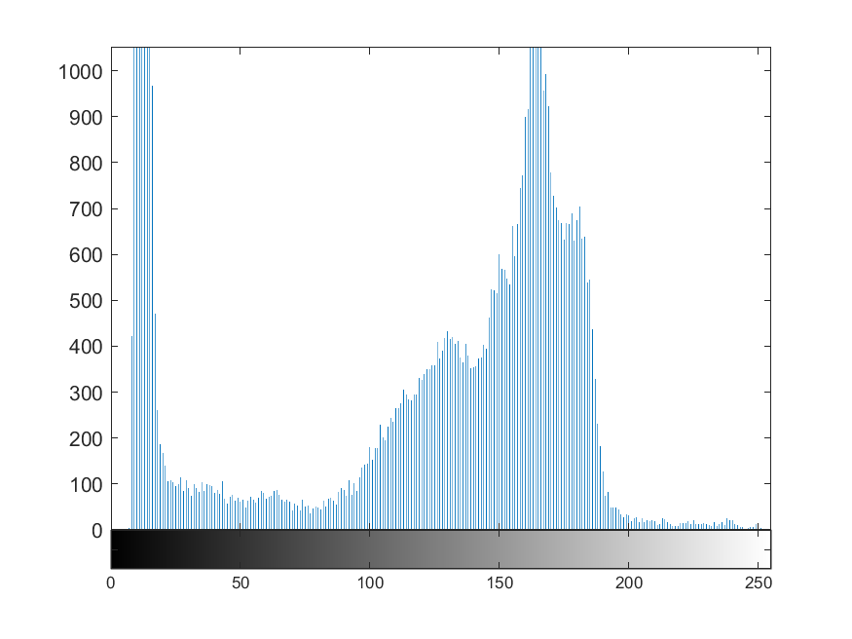
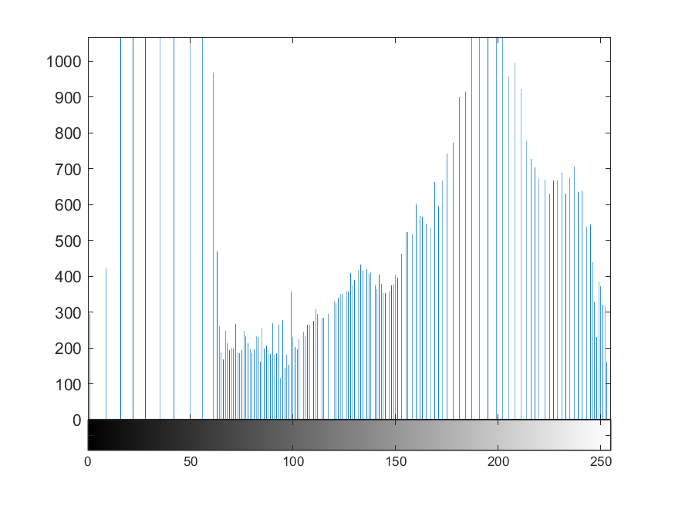
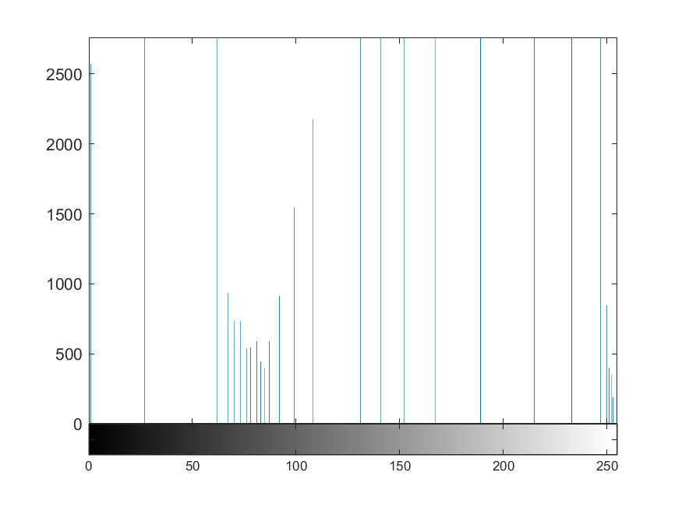
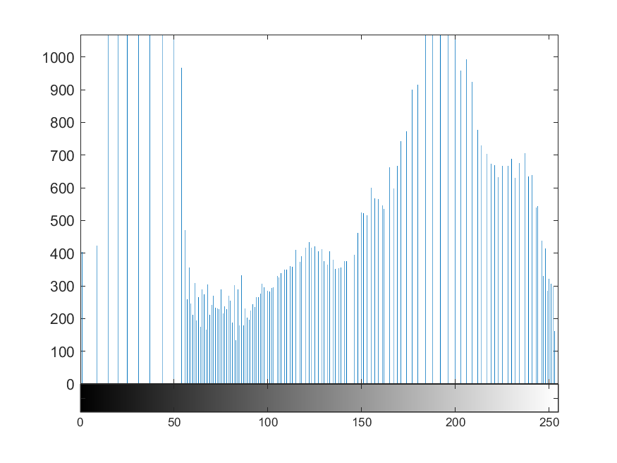
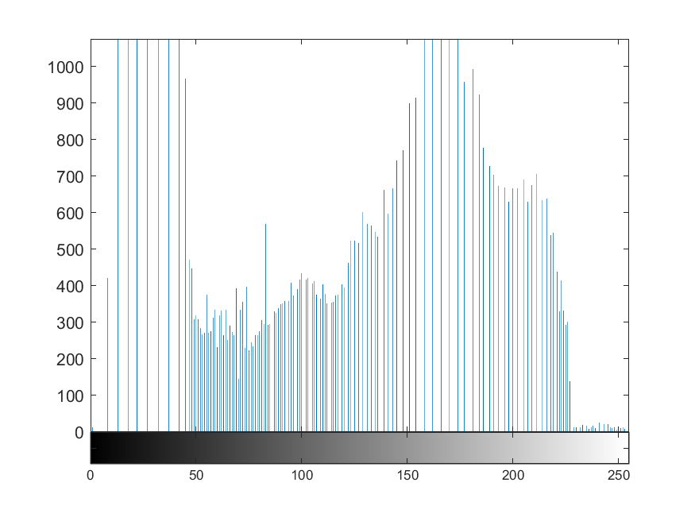
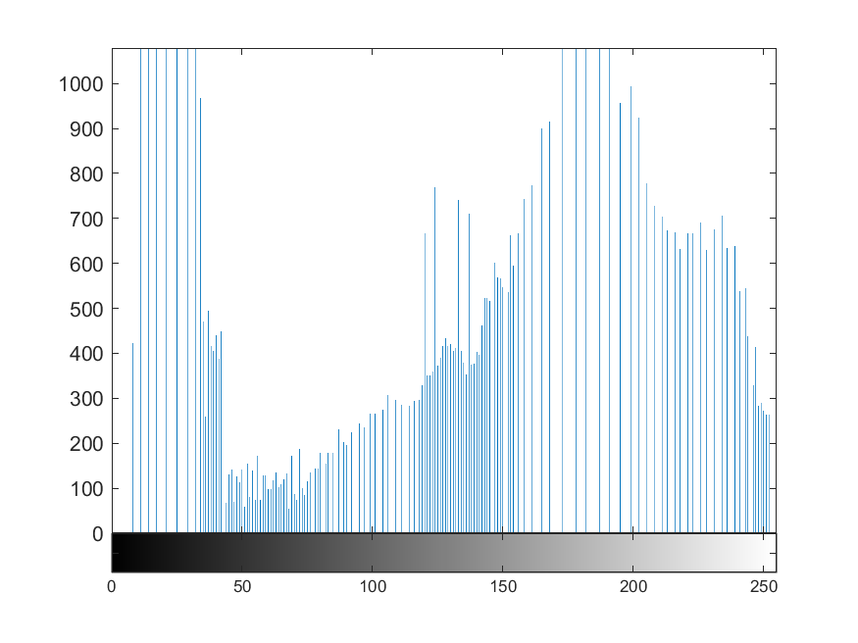
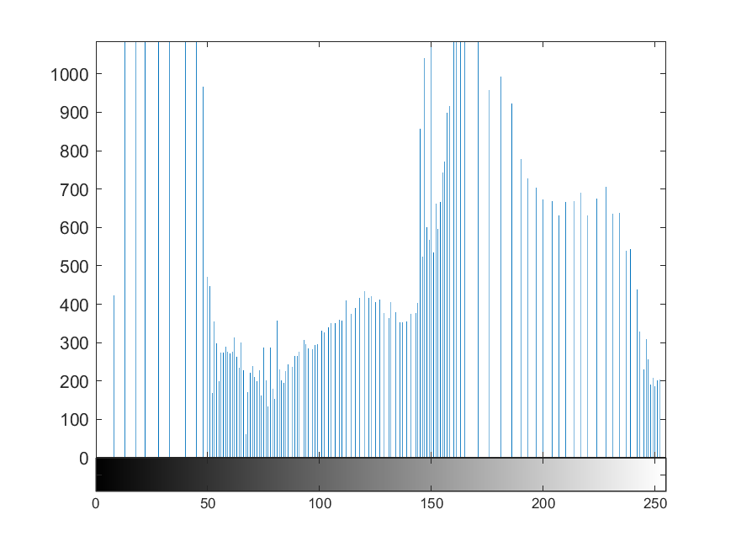
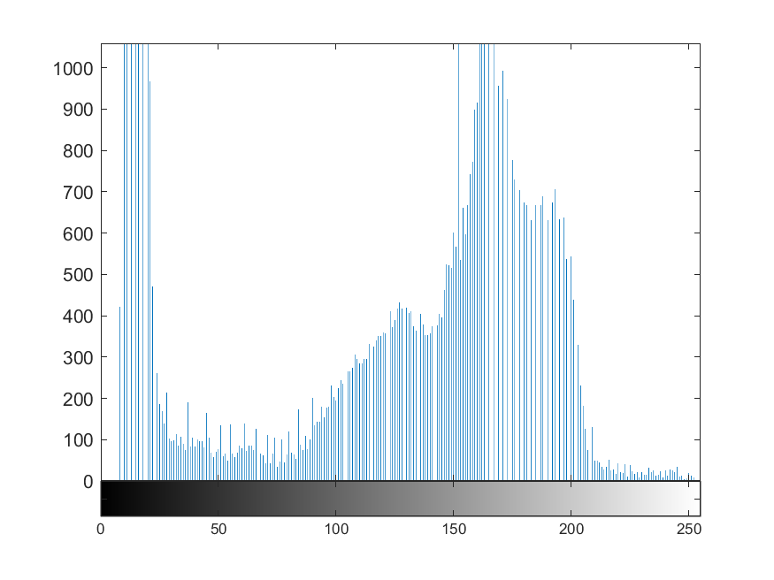
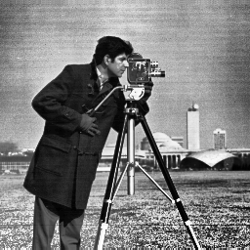
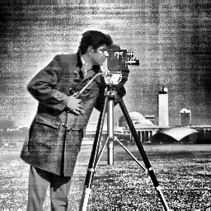
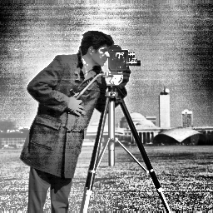
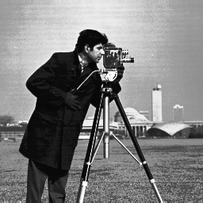
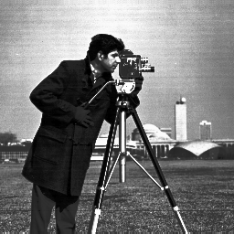

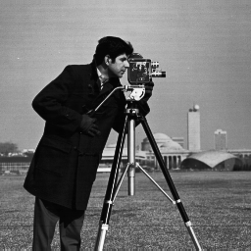
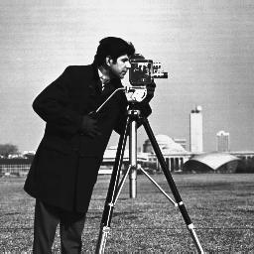
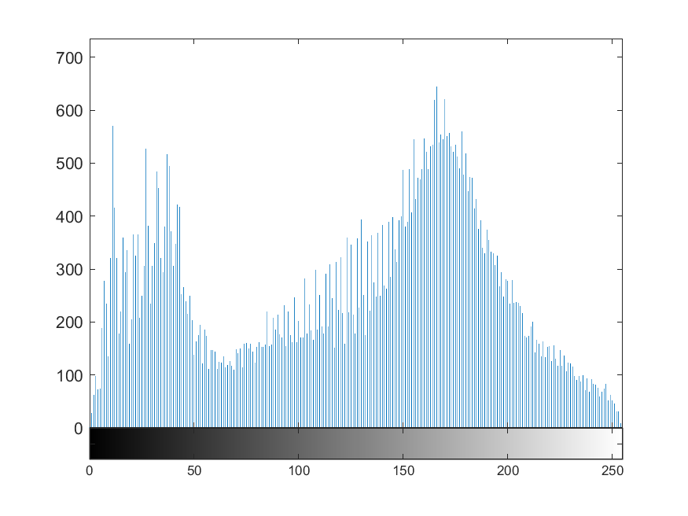
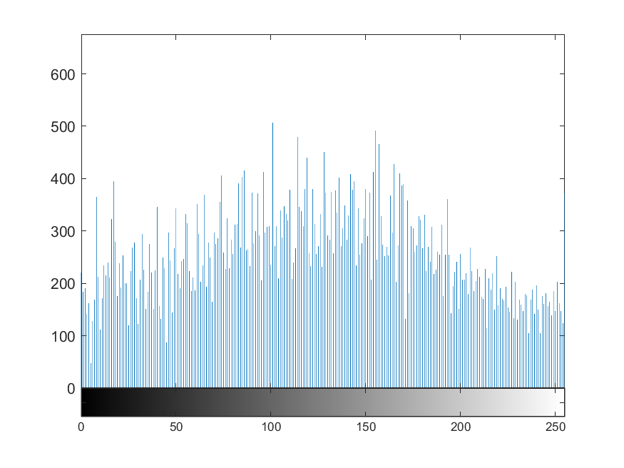
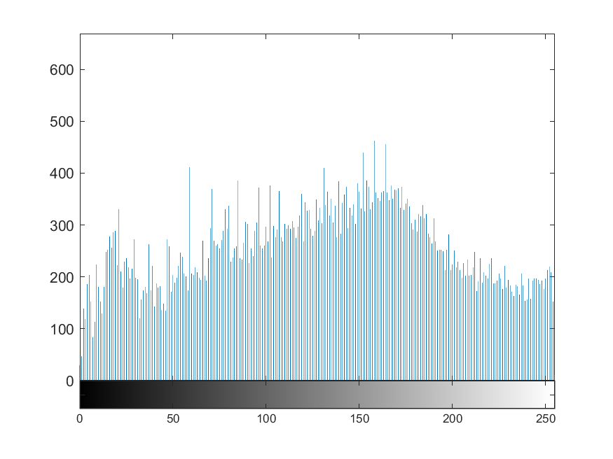
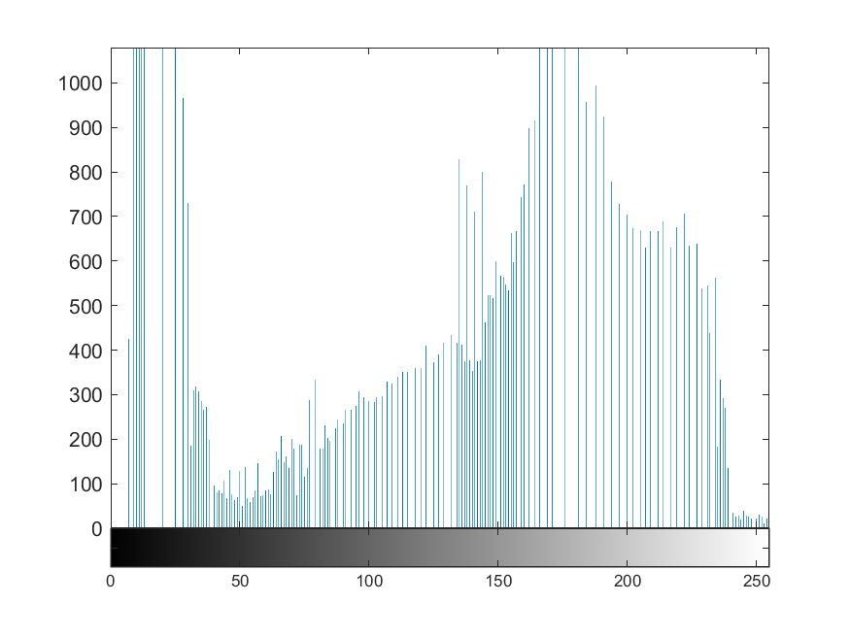
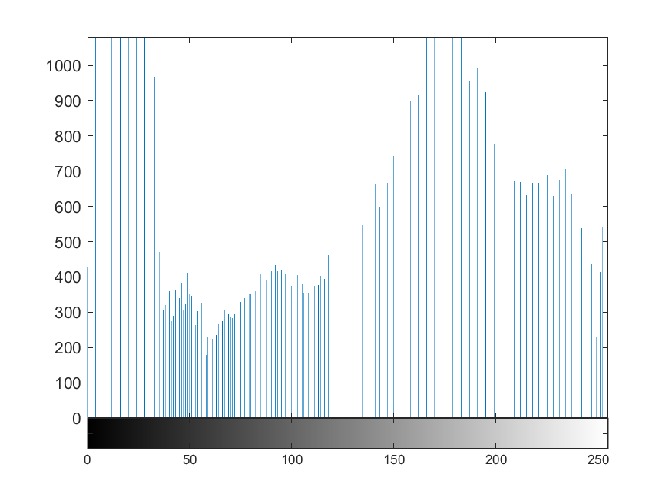
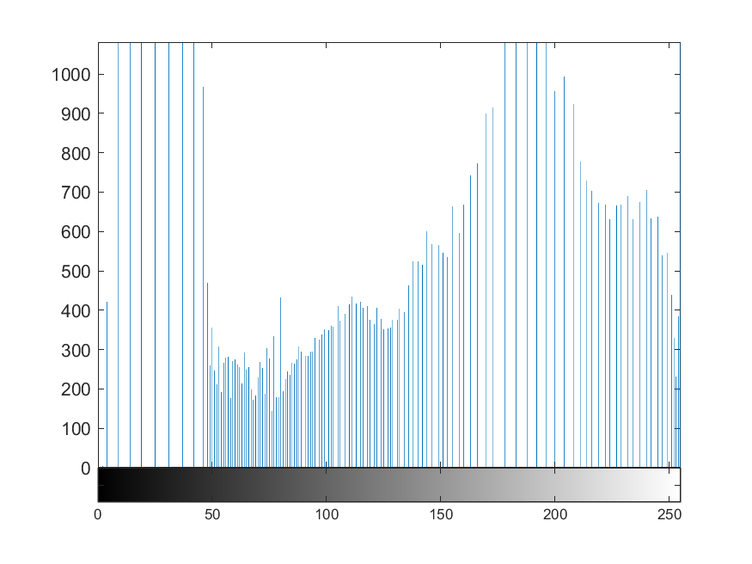
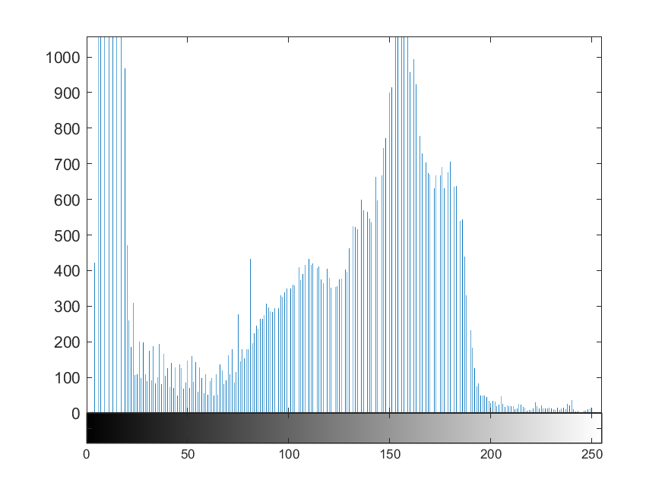
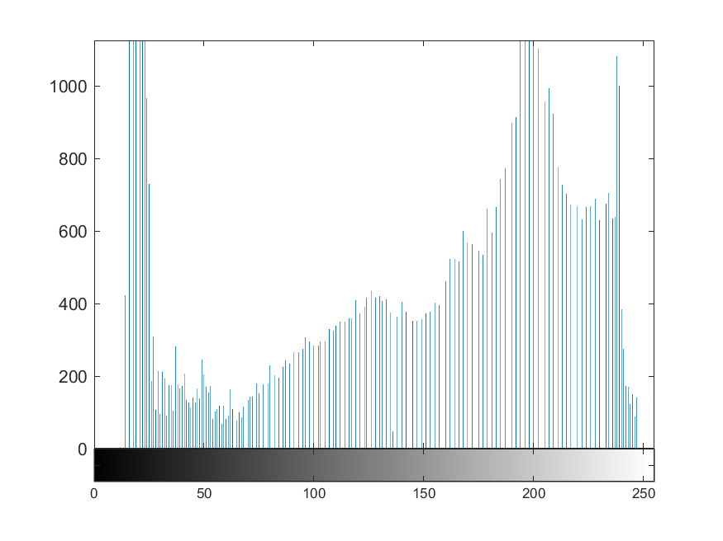
Fig.1
photographer
Original Image
Mean Brightness Preserving Histogram Equalization (MBPHE)
BBHE | QBHE | DSIHE | MMBEBHE | RMSHE | RSIHE | RSWHE
Local Histogram Equalization (LHE)
CLAHE | POSHE | AHE | BPDHE
Clipping-Based Histogram Equalization (CBHE)
WTHE | BUBOHE | AMHE | ESIHE

Slide 8
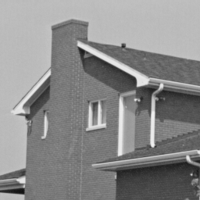

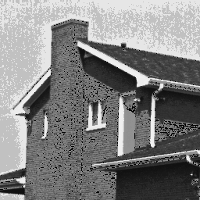


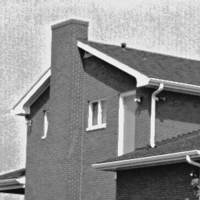
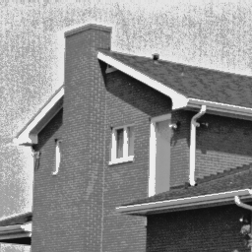
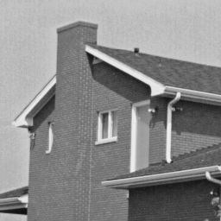
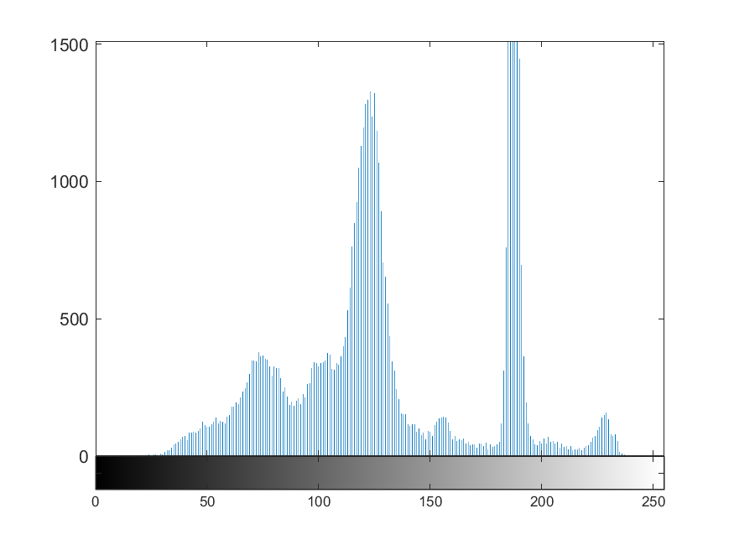
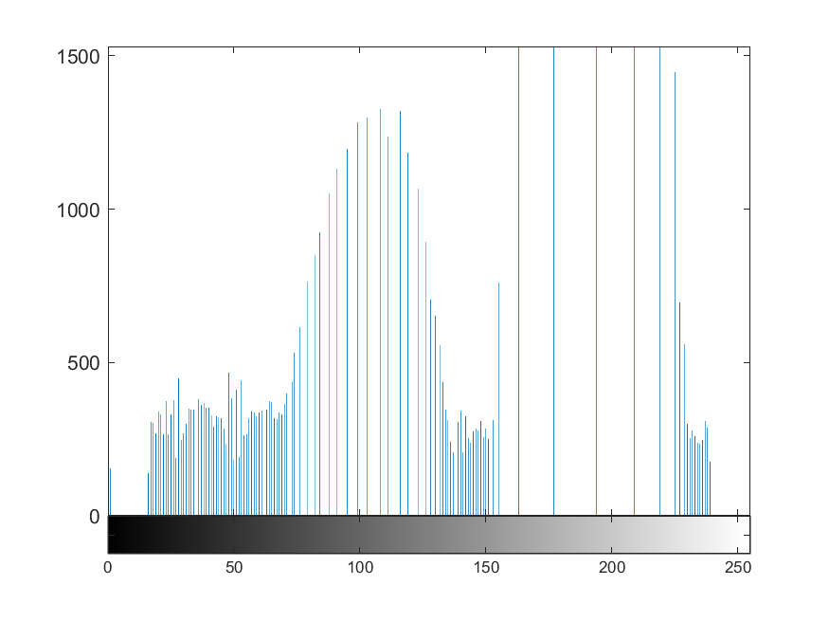
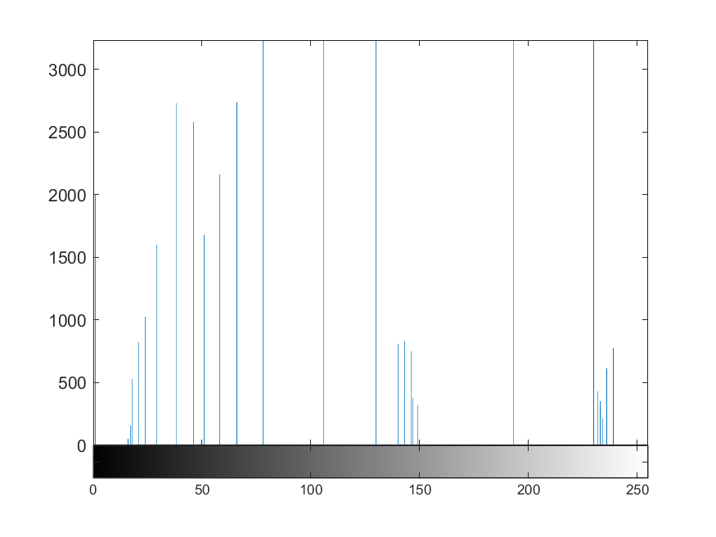

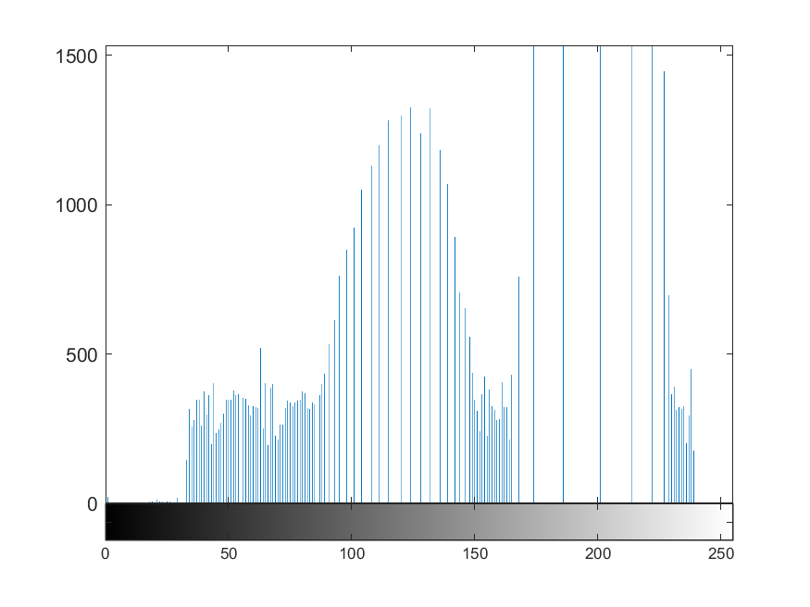
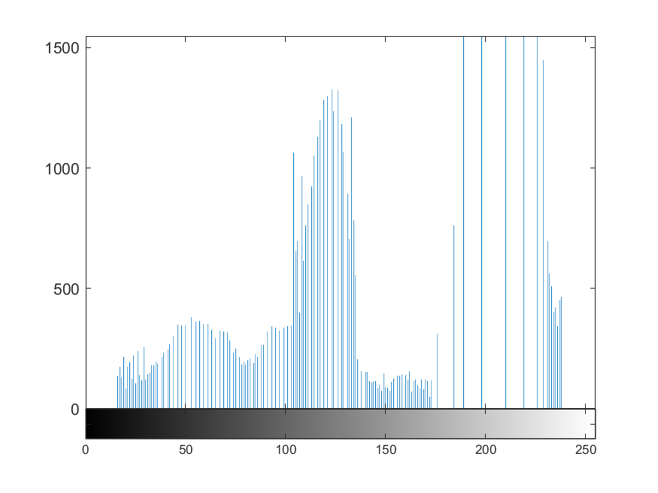
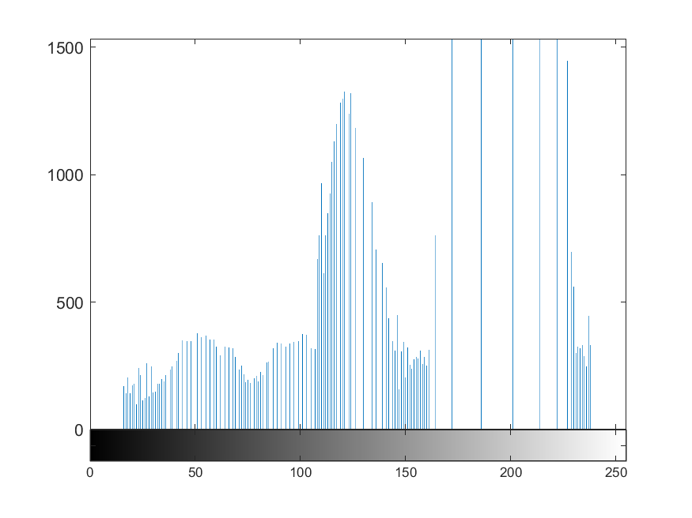
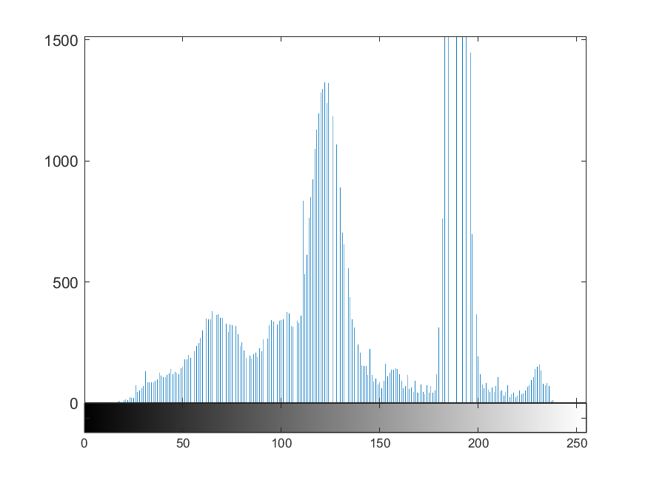
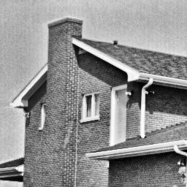
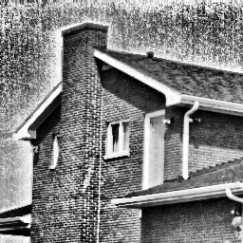
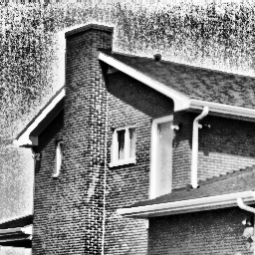
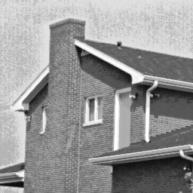
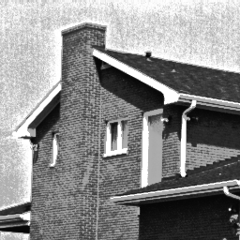


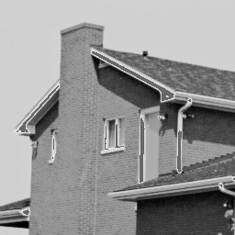
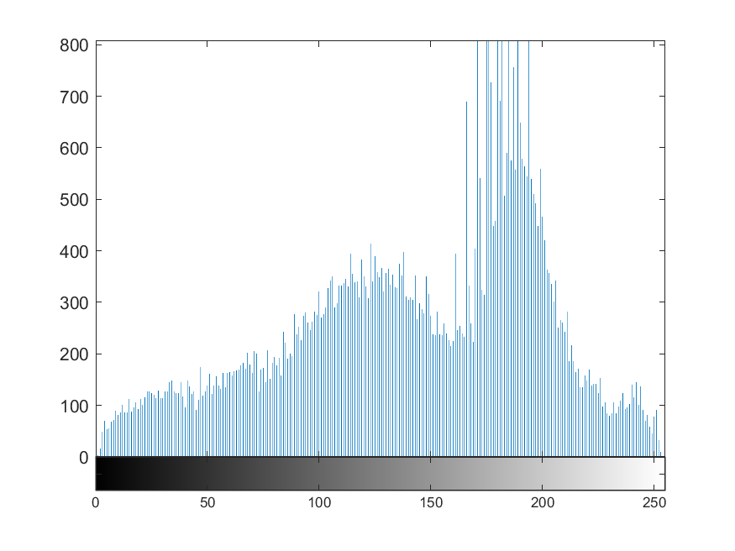
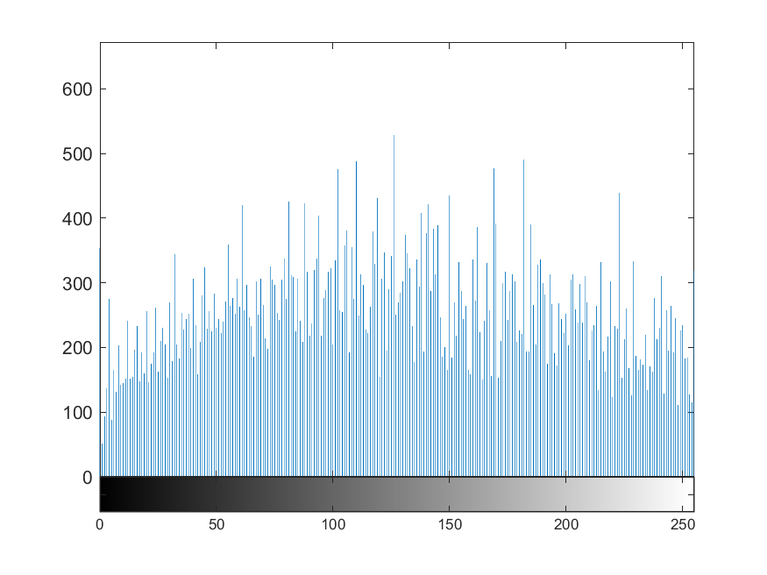






Fig.2
house
Original Image
Mean Brightness Preserving Histogram Equalization (MBPHE)
BBHE | QBHE | DSIHE | MMBEBHE | RMSHE | RSIHE | RSWHE
Local Histogram Equalization (LHE)
CLAHE | POSHE | AHE | BPDHE
Clipping-Based Histogram Equalization (CBHE)
WTHE | BUBOHE | AMHE | ESIHE

Slide 9
































Fig.3
green pepper
Original Image
Mean Brightness Preserving Histogram Equalization (MBPHE)
BBHE | QBHE | DSIHE | MMBEBHE | RMSHE | RSIHE | RSWHE
Local Histogram Equalization (LHE)
CLAHE | POSHE | AHE | BPDHE
Clipping-Based Histogram Equalization (CBHE)
WTHE | BUBOHE | AMHE | ESIHE

Slide 10
































Fig.4
starfish
Original Image
Mean Brightness Preserving Histogram Equalization (MBPHE)
BBHE | QBHE | DSIHE | MMBEBHE | RMSHE | RSIHE | RSWHE
Local Histogram Equalization (LHE)
CLAHE | POSHE | AHE | BPDHE
Clipping-Based Histogram Equalization (CBHE)
WTHE | BUBOHE | AMHE | ESIHE

Slide 11
































Fig.5
butterfly
Original Image
Mean Brightness Preserving Histogram Equalization (MBPHE)
BBHE | QBHE | DSIHE | MMBEBHE | RMSHE | RSIHE | RSWHE
Local Histogram Equalization (LHE)
CLAHE | POSHE | AHE | BPDHE
Clipping-Based Histogram Equalization (CBHE)
WTHE | BUBOHE | AMHE | ESIHE

Slide 12
































Fig.6
plane
Original Image
Mean Brightness Preserving Histogram Equalization (MBPHE)
BBHE | QBHE | DSIHE | MMBEBHE | RMSHE | RSIHE | RSWHE
Local Histogram Equalization (LHE)
CLAHE | POSHE | AHE | BPDHE
Clipping-Based Histogram Equalization (CBHE)
WTHE | BUBOHE | AMHE | ESIHE

Slide 13
































Fig.7
parrot
Original Image
Mean Brightness Preserving Histogram Equalization (MBPHE)
BBHE | QBHE | DSIHE | MMBEBHE | RMSHE | RSIHE | RSWHE
Local Histogram Equalization (LHE)
CLAHE | POSHE | AHE | BPDHE
Clipping-Based Histogram Equalization (CBHE)
WTHE | BUBOHE | AMHE | ESIHE

Slide 14
































Fig.8
woman
Original Image
Mean Brightness Preserving Histogram Equalization (MBPHE)
BBHE | QBHE | DSIHE | MMBEBHE | RMSHE | RSIHE | RSWHE
Local Histogram Equalization (LHE)
CLAHE | POSHE | AHE | BPDHE
Clipping-Based Histogram Equalization (CBHE)
WTHE | BUBOHE | AMHE | ESIHE

Slide 15





























Fig.9
sitting woman
Original Image
Mean Brightness Preserving Histogram Equalization (MBPHE)
BBHE | QBHE | DSIHE | MMBEBHE | RMSHE | RSIHE | RSWHE
Local Histogram Equalization (LHE)
CLAHE | POSHE | AHE | BPDHE
Clipping-Based Histogram Equalization (CBHE)
WTHE | BUBOHE | AMHE | ESIHE

Slide 16
































Fig.10
ship
Original Image
Mean Brightness Preserving Histogram Equalization (MBPHE)
BBHE | QBHE | DSIHE | MMBEBHE | RMSHE | RSIHE | RSWHE
Local Histogram Equalization (LHE)
CLAHE | POSHE | AHE | BPDHE
Clipping-Based Histogram Equalization (CBHE)
WTHE | BUBOHE | AMHE | ESIHE

Slide 17
































Fig.11
man
Original Image
Mean Brightness Preserving Histogram Equalization (MBPHE)
BBHE | QBHE | DSIHE | MMBEBHE | RMSHE | RSIHE | RSWHE
Local Histogram Equalization (LHE)
CLAHE | POSHE | AHE | BPDHE
Clipping-Based Histogram Equalization (CBHE)
WTHE | BUBOHE | AMHE | ESIHE

Slide 18
































Fig.12
room
Original Image
Mean Brightness Preserving Histogram Equalization (MBPHE)
BBHE | QBHE | DSIHE | MMBEBHE | RMSHE | RSIHE | RSWHE
Local Histogram Equalization (LHE)
CLAHE | POSHE | AHE | BPDHE
Clipping-Based Histogram Equalization (CBHE)
WTHE | BUBOHE | AMHE | ESIHE

